Slide 1
The Relationship between Daylight Savings Time and Driving Fatalities
Presented by: Andrew Anastasiades, Peter Drozdzewicz, Viera Garcia, Taylor Sperry, and Sindhura Surapaneni
Date: 5/1/2021
Notes:
Taylor: slide 2-7
Andrew: 8-11
Peter: 12-15
viera : 16-17
sindhura: 19-end

Slide 2
BACKGROUND
Not every state in America participates in Daylight Savings, such as AZ and HI.
Georgia's House of Representatives has approved a bill that could end the state's tradition of springing forward and falling back the clock twice every year.
https://www.ajc.com/politics/hate-the-time-switch-here-is-why-georgia-will-probably-keep-daylight-saving-time-for-now/YZTWT2BTKNCGNEJA5LQRNVHRXE/

Slide 3
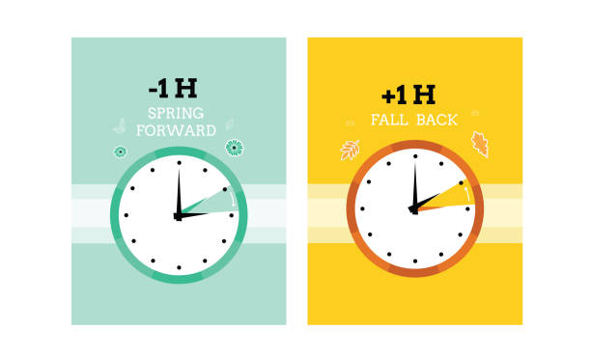
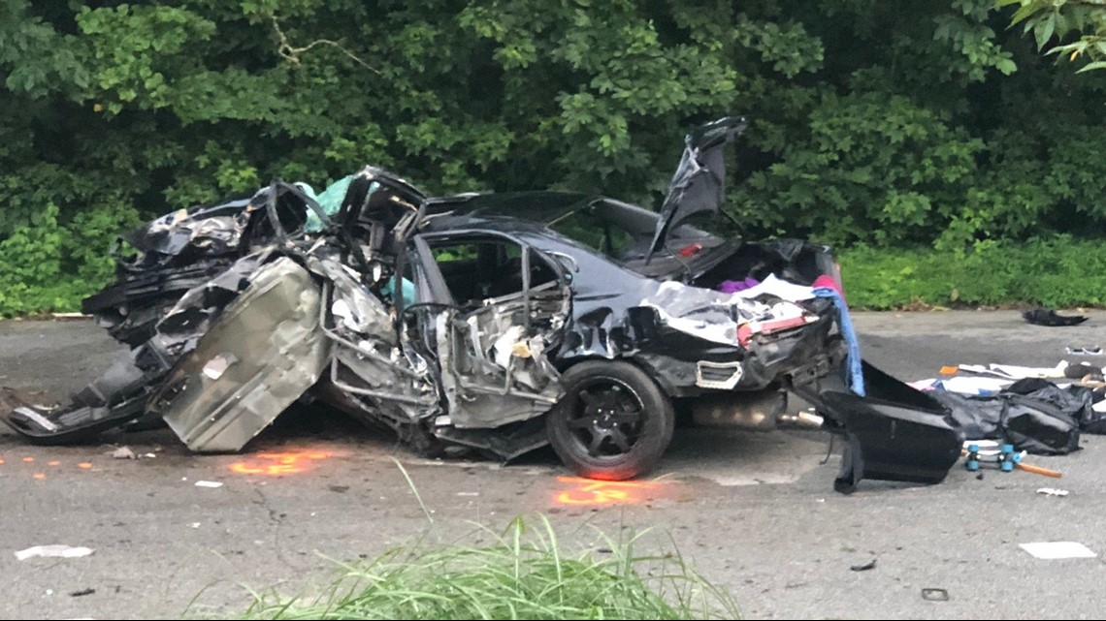

Summary
We want to find out if there is a correlation between the effects of Daylight Savings (ie. time change, lighting, ect) and the amount of fatalities due to car crashes that occur in the 48 states with DLS.

Slide 4
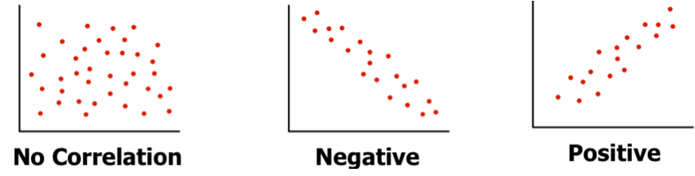
Hypothesis
Null Hypothesis (H₀):
There is no significant relationship between fatal car accidents and Daylight Saving in the 48 states that participate in Daylight Savings.
Alternative Hypothesis (H₁):
There is a significant relationship between fatal car accidents and Daylight Savings.

Slide 5
QUESTIONS
Are there more car accidents during Daylight Savings?
Does DLS have an effect on the increase of car crashes?
Are there more car accidents after DLS compared to the week before it occurs?
Are there more car accidents after DLS in states that have DLS compared to states that don’t have DLS?

Slide 6
Study Population
Eligible participants were drivers who had been involved in fatal accidents in the United States during the years of 2016, 2017, 2018 and 2019.
Data derived from “The Fatality Analysis Reporting System (FARS) National Highway Traffic Safety Administration”

Slide 7
Data Source/Cleaning
Of over 90 different elements, only used those relevant for our regression analysis
Focused on the weeks of Daylight Savings periods each year

Slide 8
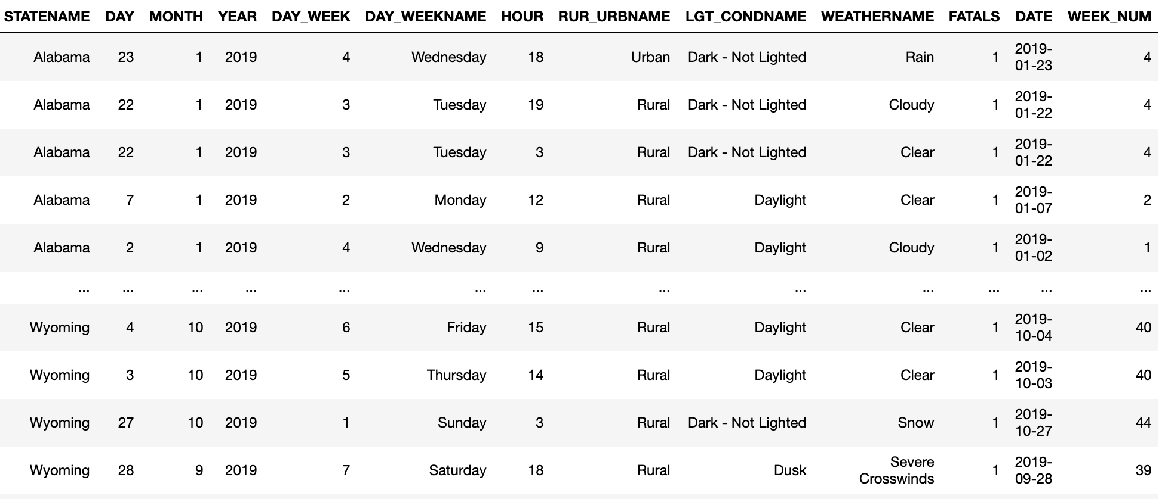
Inspect Data - 2019

Slide 9
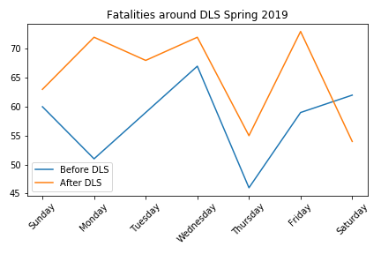
Spring 2019
We want to see if there are increased fatalities after DLS...
Nice visual, but we
need to quantify

Slide 10
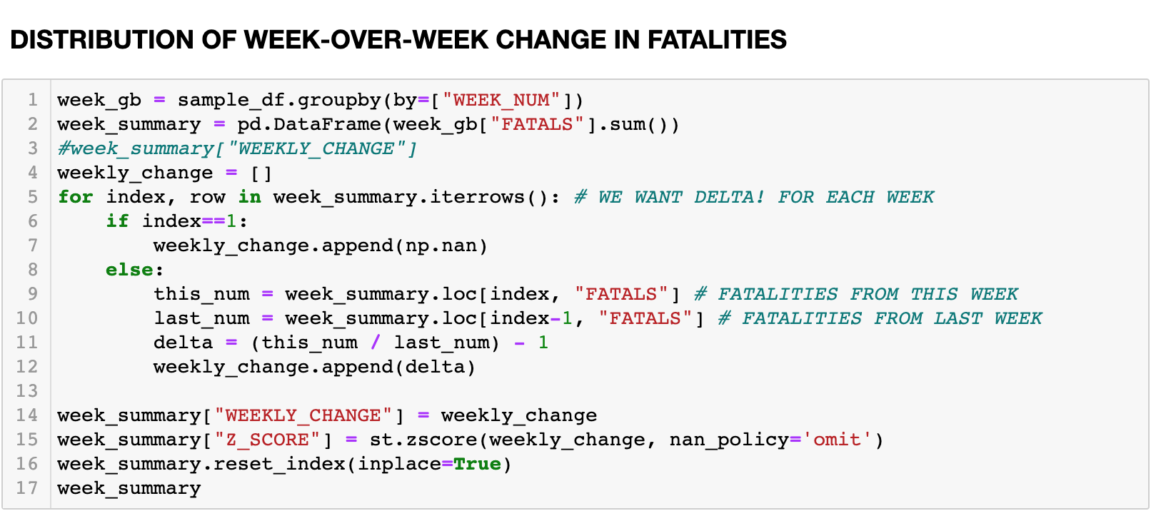
Sample Code (Single Year)

Slide 11
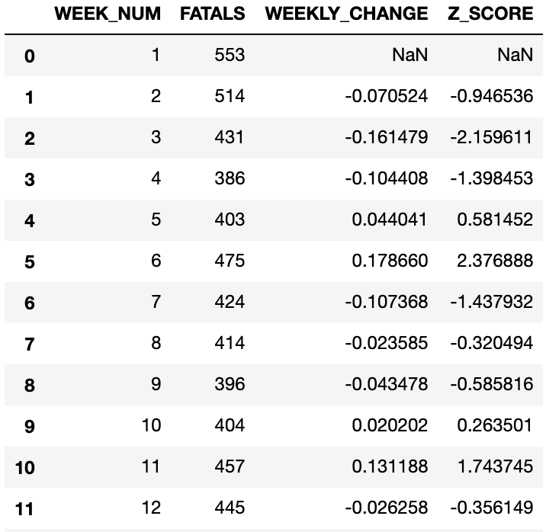
Sample Code (Single Year)
Delta accounts for many seasonal factors
Delta_{i} = (Fatals_{i} / Fatals_{i-1}) - 1

Slide 12
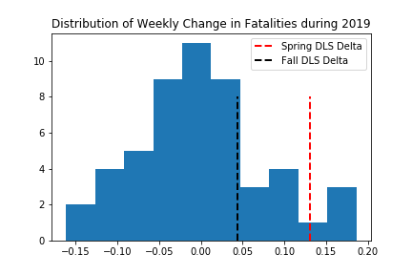
Fatality Delta
Looks Promising!
What about other years?

Slide 13
Challenges for Multiple Years
Files are large
15 MB zip
80 MB unzipped
Previous years have different fields
DLS are on different day each year
Alter code to be more dynamic

Slide 14
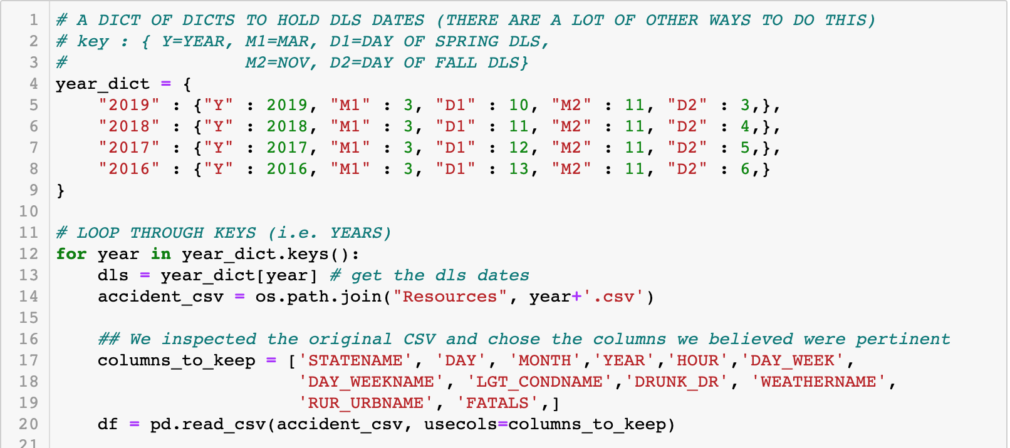
Dynamic Dates

Slide 15
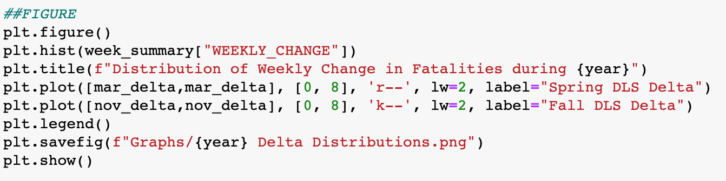
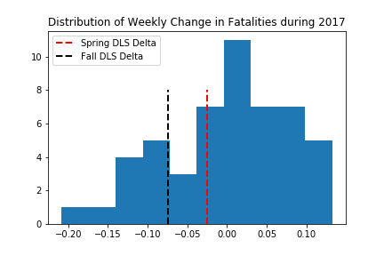
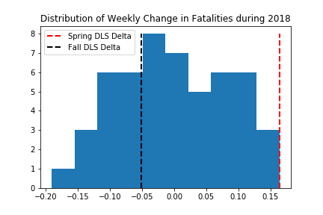
Generating Plots - Sample

Slide 16
Data Analysis
Line Graphs were created for both the Daylight Savings transition weeks in Spring and Fall
Additionally, a chain of histograms were generated for the purpose of modeling the change in fatalities for each year as well
The fatality charts use a format where before DLS is the point before a state would enact the DLS time change, and after DLS is the point when the time change is active

Slide 17
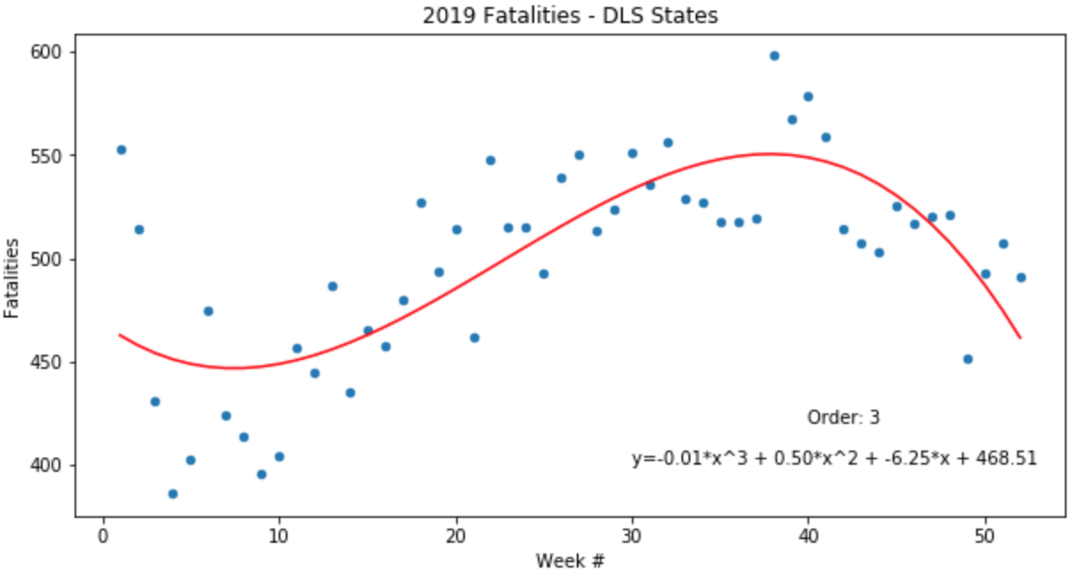
Regression Analysis

Slide 18
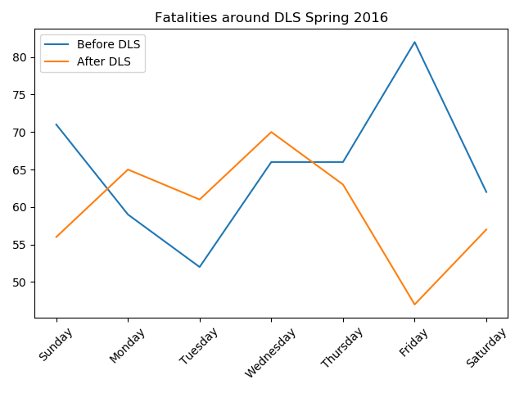
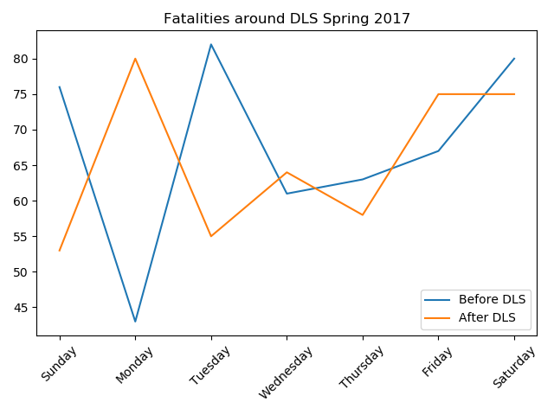
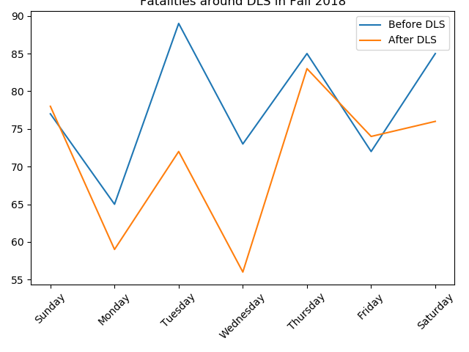
Spring Fatalities 2016-2018 (Observe DLS)
The amount of car crash fatalities in 2016 and 2017 increase initially during DLS.
But, in 2018, the amount of car crash fatalities initially decrease during DLS, then increase.
This means there is not an observable significant change due to DLS

Slide 19
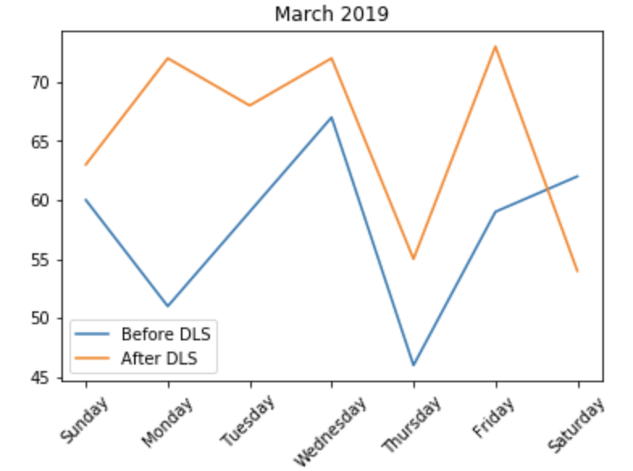
Spring Fatalities 2019 (Observe DLS)
During DLS, the amount of fatalities increased greatly compared to before
This is the significant correlation we were looking to find!

Slide 20
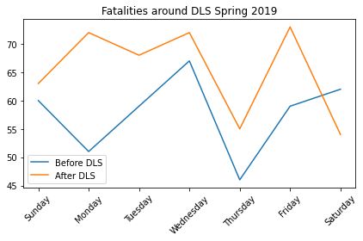
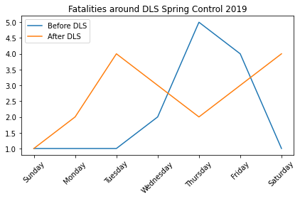
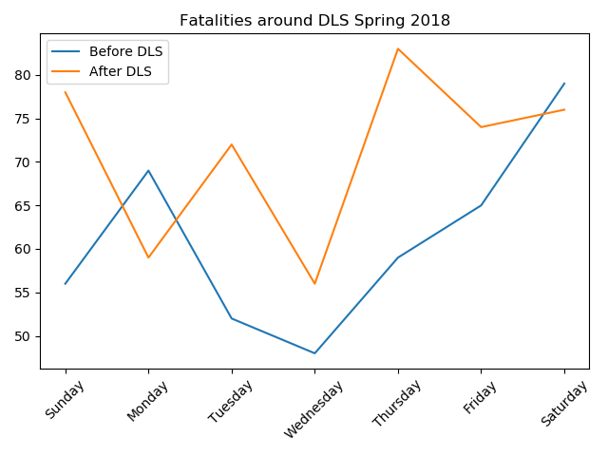
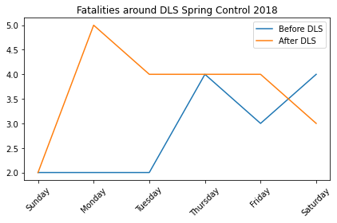
Spring Fatalities (Not Observing DLS)-Control
vs.
vs.
Notes:
The charts above looked to find additional correlations between States that do observe DLS during DLS. States that do not observe DLS did not, but due to the limited number of states in the USA that could be classified as a control, there was not enough additional control data to support our Hypothesis. It is worth noting that the states that do not observe DLS have much larger influxes in fatalities during the DLS transition periods, which is an additional topic worth exploring.

Slide 21
Spring and Fall Fatality Comparison
Overall, the fatality charts presented do not show a direct correlation between amount of car crash fatalities and the onset of Daylight Savings.
The only figure that truly displayed a significant change as a result of DLS was Spring 2019.

Slide 22
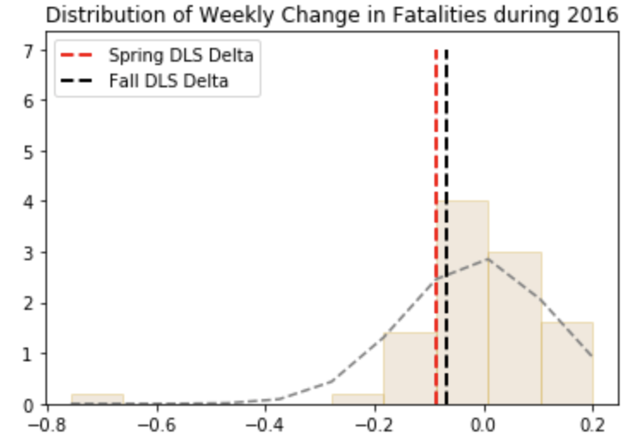
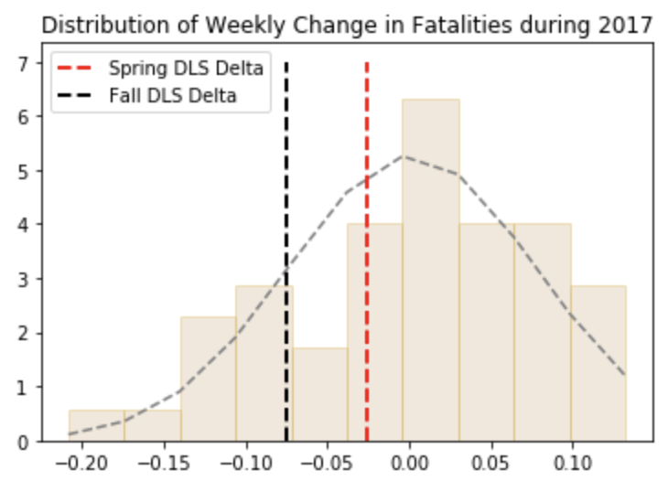
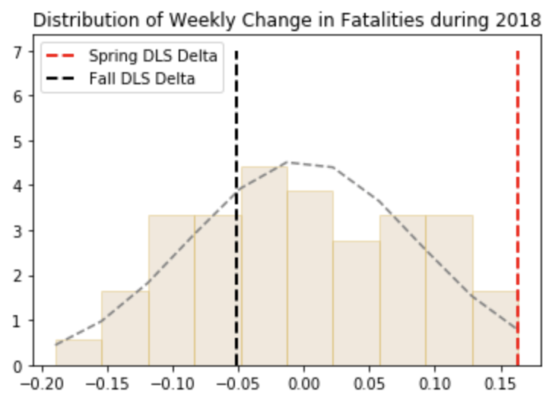
Fatality Distribution (2017-2019)
The values shown above demonstrate that...

Slide 23
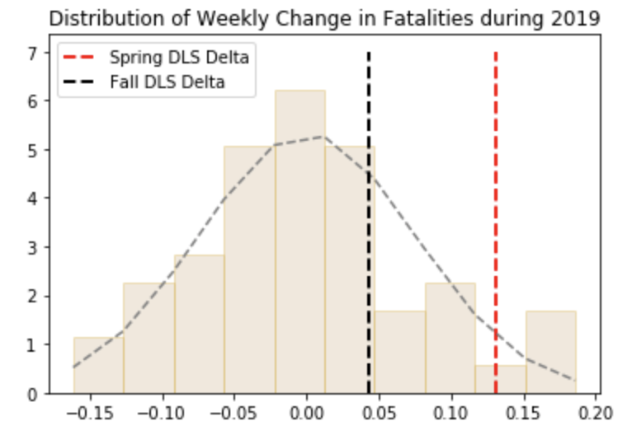
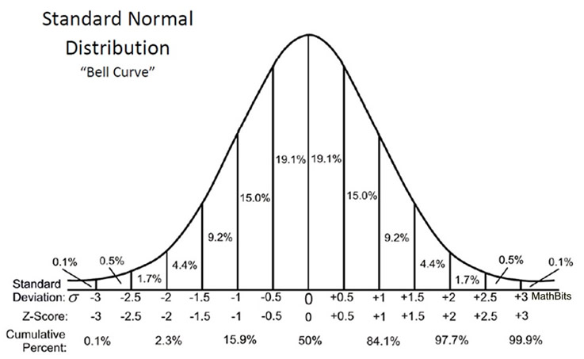
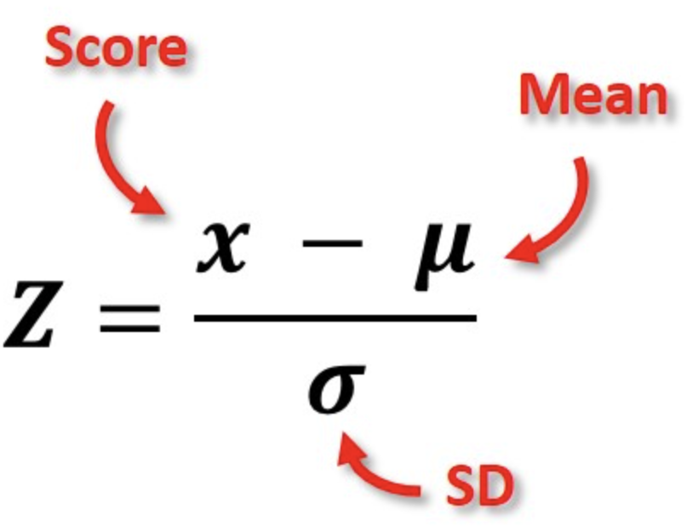
Week Distribution of Fatal Accidents
Source : Understanding Z-Scores - MathBitsNotebook(A2 - CCSS Math)
Ho: u = 0.00
H1: u > 0.00
α = 0.05, α < p-value. We fail to reject the null hypothesis

Slide 24
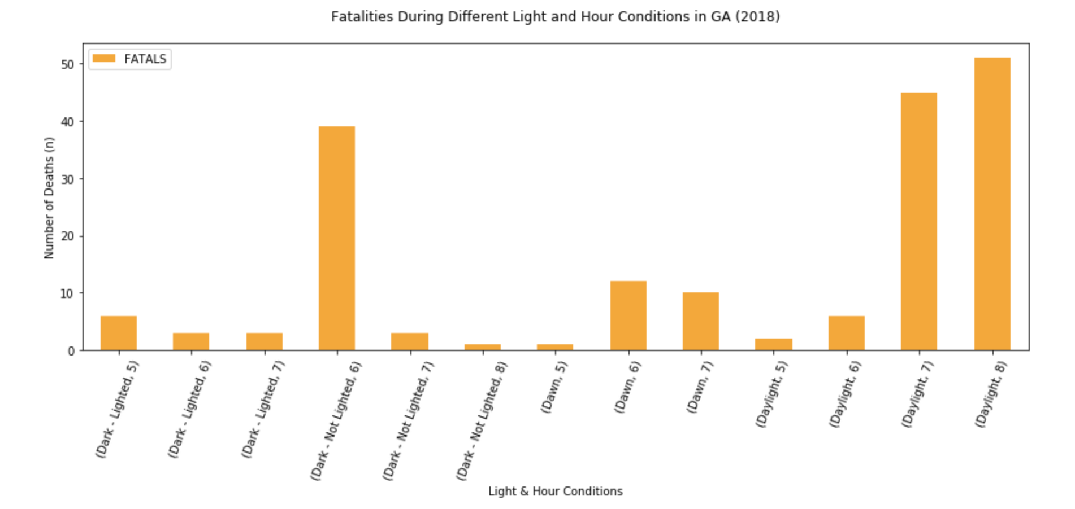
Additional Figures
An interesting point that was discovered observing the relationship between deaths/light was that...

Slide 25
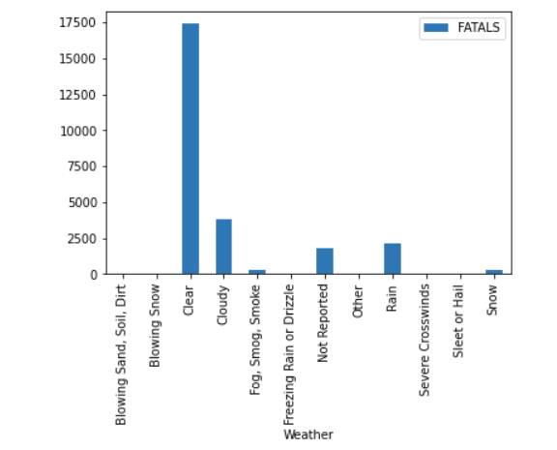
Additional Figures
Analysing the impact of Weather on Fatalities

Slide 26
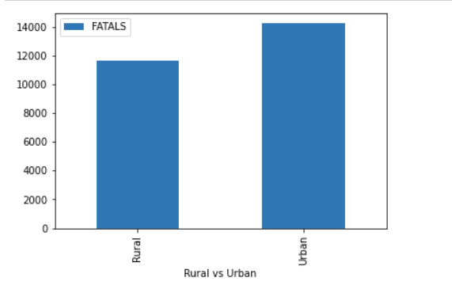
Additional Figures
Analysing the Fatalities by Area Type

Slide 27
Statistical Analysis
Since our P-values in most years were more than our alpha (0.05), the alternative hypothesis was rejected. Meaning that there is no significant relationship between fatal car accidents and Daylight Saving in the 48 states that participate in Daylight Savings.

Slide 28
Conclusions
We cannot say there is a correlation between DLS and car crash fatalities.
The change in frequency of fatalities was not significant enough to reject our initial hypothesis
2018 was the only year that showed a positive correlation.
In the Fall, Halloween was a limitation in observing data.
Our recommendation is to focus on different data sets that consider other factors (sleep cycle, car crashes that were not fatalities, ect)
Change the independent variable
Also, account for more variables, and breaking down the data with more sorting

Slide 29
Questions?

Slide 30
Backup Slides

Slide 31
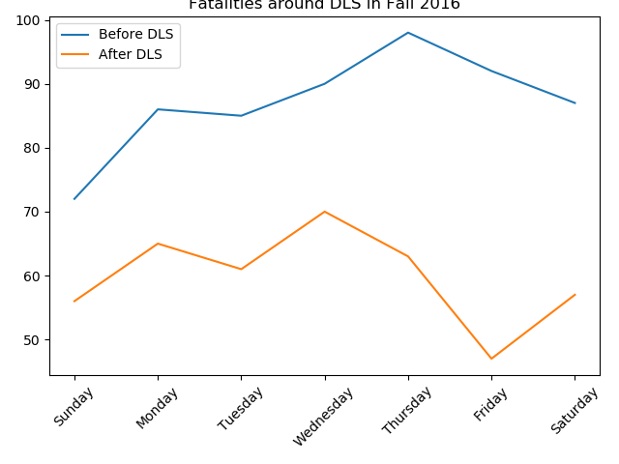
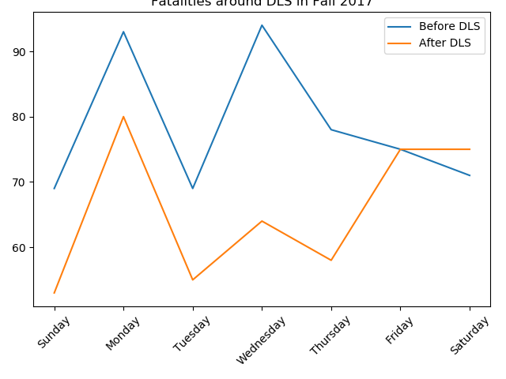
Fall Fatalities 2016-2018 (Observe DLS)
In all of the graphs, the amount of car crash fatalities decrease during DLS.

Slide 32
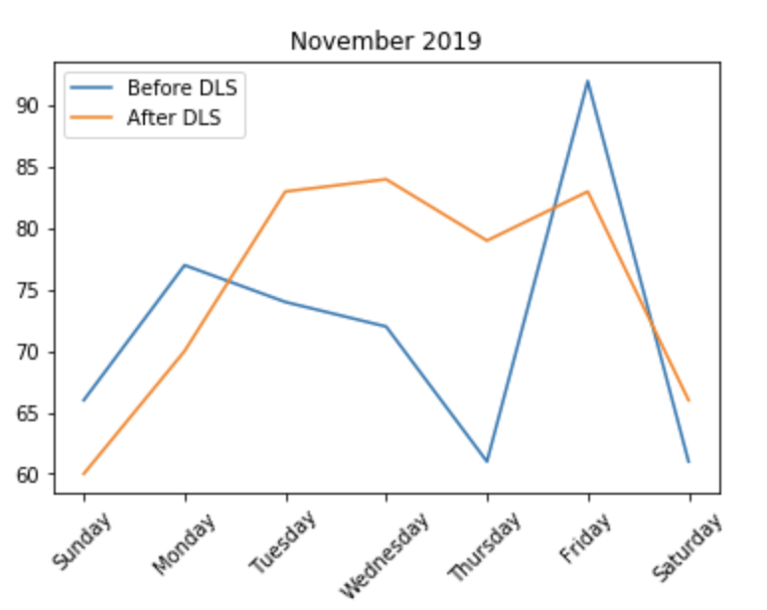
Fall Fatalities 2019 (Observe DLS)
The amount of fatalities steadily increase and decrease at the end. The spike is Halloween.

